Slide 1
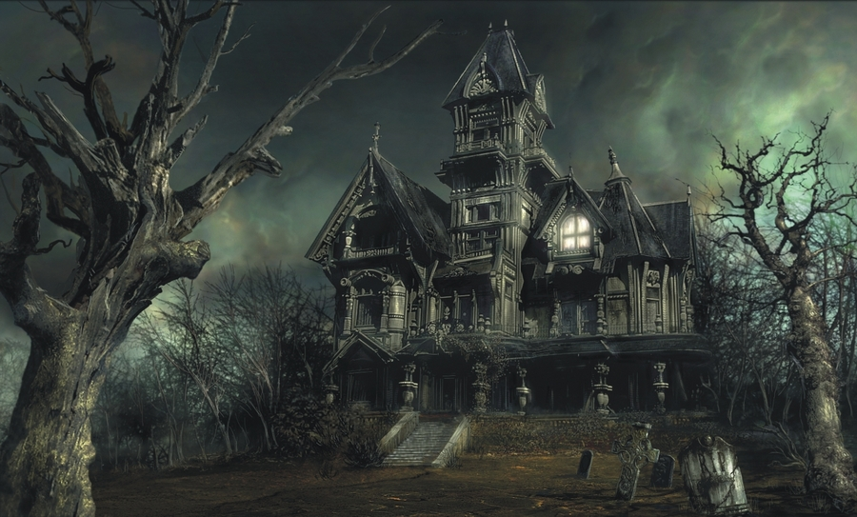
PYTHON HAUNTED HOUSE Part 2 the hauntening

Slide 2
Character.py
Create a character class file called Character.py
Copy the code from here into the file

Slide 3

Character_Test.py
Create a new file called Character_Test.py
This is where we will build our character
Create a character and use the describe method to check it works

Slide 4
Character.py & Character_test.py
Examine the Character class inside character.py to find the name of the method which sets the conversation attribute
Add code to character_test.py to call this method and give Dave a line of dialogue
Add code to character_test.py to call a different method which talks to Dave

Slide 5

Character.py
Create a new class under the Character class. This is a SUB CLASS and INHERITS the ATTRIBUTES & METHODS of the parent class

Slide 6

Character_test.py
Change your character to the new sub class Enemy

Slide 7
Character.py
Add getter and setter methods to Enemy so that you can add a weakness for an enemy
Look at how you did this for room.py and items.py if you are stuck

Slide 8
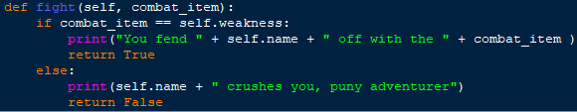
Character.py
Give your Enemy the ability to Fight:

Slide 9

Character_test.py
Set the Enemies Weakness to an item of your choice using your setter.
Call the fight method with:

Slide 10
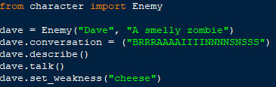
Main.py
Add our enemy code to the main game.

Slide 11
Room.py
Adding a character to a room
An object in another object is called aggregation
Add an attribute so a room can have a character
Add getter and setter methods to enable putting a character inside a room

Slide 12
Main.py
Adding an Enemy to a room

Slide 13
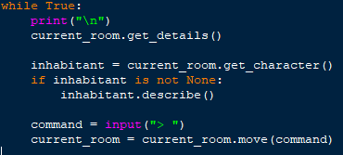
Main.py
Add this check using your getter to see if the room has a character in it.

Slide 14

Main.py
Expanding the game loop
Add some functionality to the game loop so that different commands can be recognised. For example, your program should react to the following user inputs:
“talk” – talk to the inhabitant of this room (if there is one)
“fight” – ask what the player would like to fight with, and then fight the inhabitant of this room (if there is one)

Slide 15
Main.py
If you lose a fight with an enemy, the game should end. Hint: the fight method we wrote in the Enemy class returns True if you survive, and False if you do not

Slide 16
Main.py
Add an additional enemy character to inhabit a different room in your game. Perhaps you might want to add more methods in the Enemy class in order to be able to interact with enemies in other ways. For example, can you steal from an enemy, bribe an enemy, or send it to sleep?

Slide 17
Main.py
For a bigger challenge, why not extend the Character class in a different way? Perhaps you could create a Friend subclass with some custom methods and attributes. For example, you could hug the friendly character, or offer them a gift. You can use the built in Python function isinstance() to check whether an object is an instance of a particular class.

